Slide 1

Fsm in ecg filter
ECG Filter

Slide 2
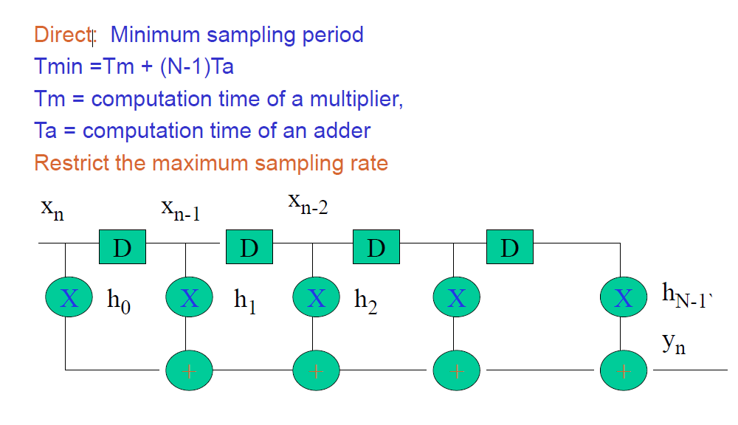
Direct form 1

Slide 3
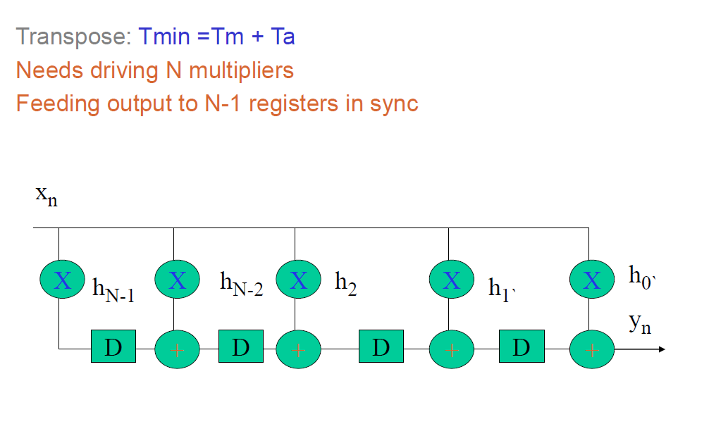
Direct form 2- pipelined

Slide 4
FSM learning 1:https://www.youtube.com/playlist?list=PLBlnK6fEyqRgp46KUv4ZY69yXmpwKOIev FSM WITH OUTPUT CLASSIFIED INTO TWO 1. MEALY 2.MOORE
Mealy state machine requires less no of states compared to moore state machine for same logic
Mealy state machine – depends on present state and i/p
Moore state machine – depends on present state only
Learnt constructing state diagram >> state table>>ffl
From ffl >> state table >> state diagram
Mealy <<--- -->> Moore
ASM chart representation

Slide 5
FSM
FSM – Controls the behaviour of system
State memory
Next state logic
Output logic
FSM is defined by list of its states and triggering condition
Timing of FSM controlled by clock signal ,at every clock cycle FSM goes to next state and generate a new set of output signal .

Slide 6
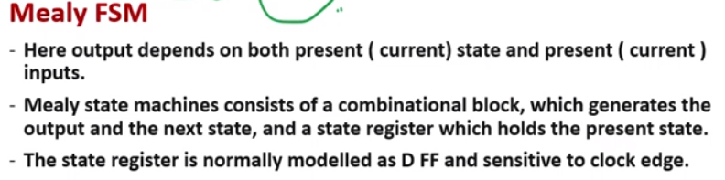

Slide 7
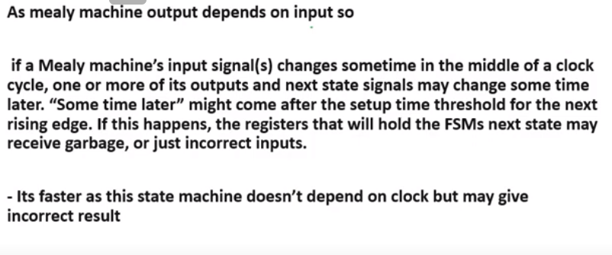

Slide 8
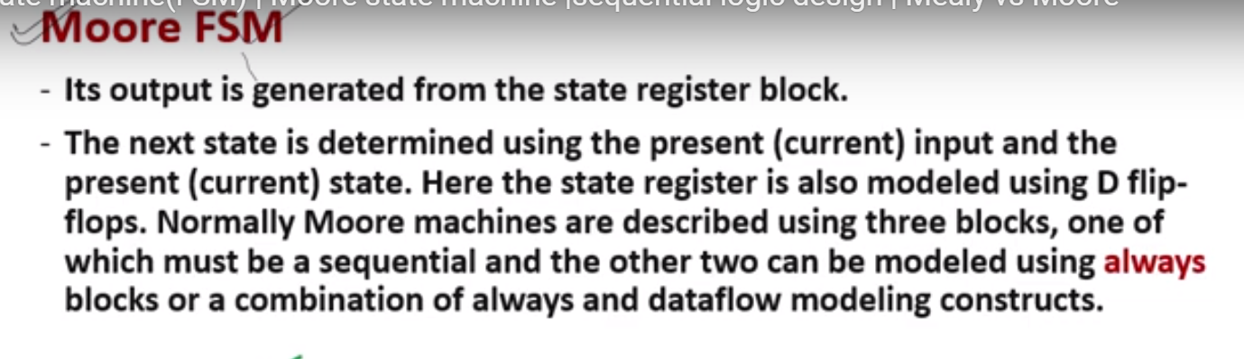

Slide 9
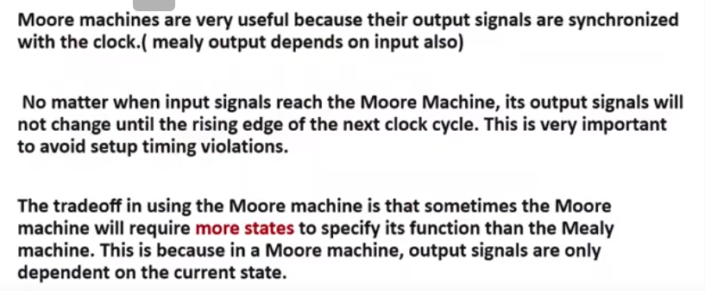

Slide 10
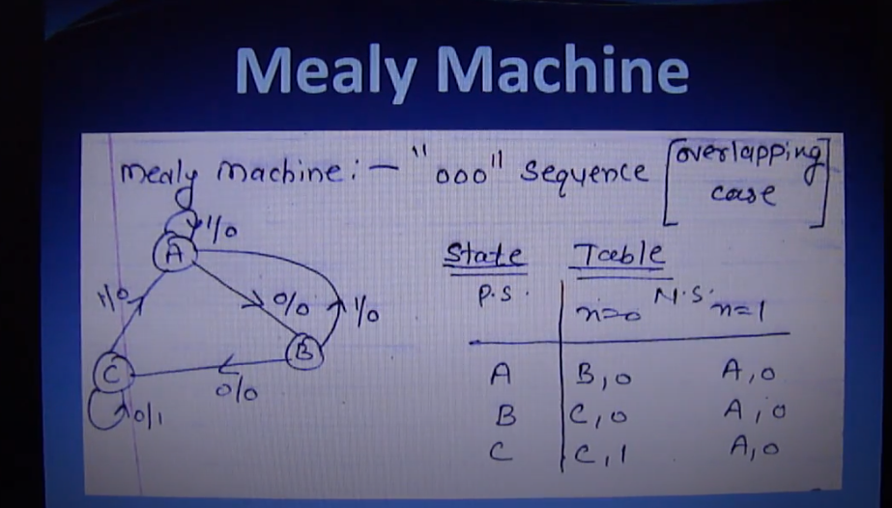

Slide 11
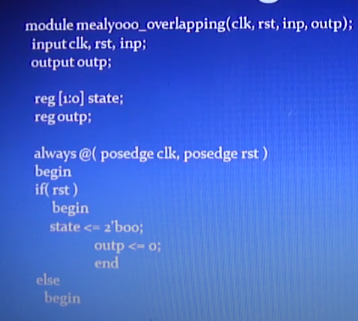

Slide 12
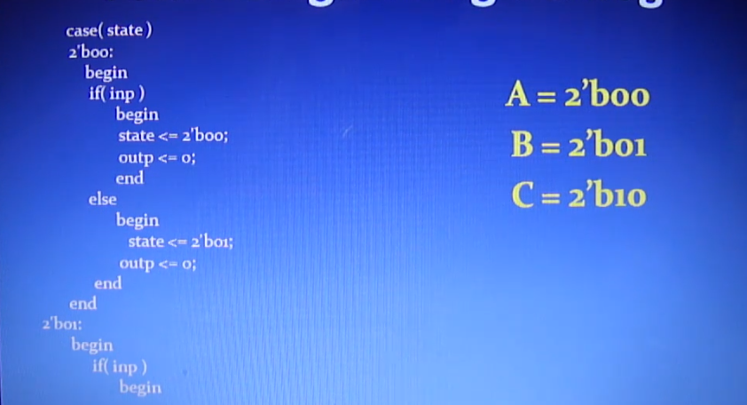

Slide 13
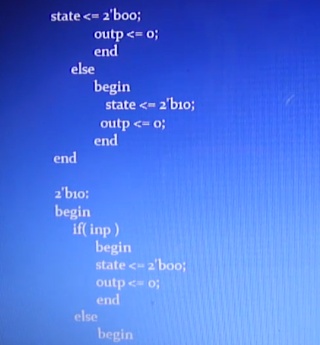
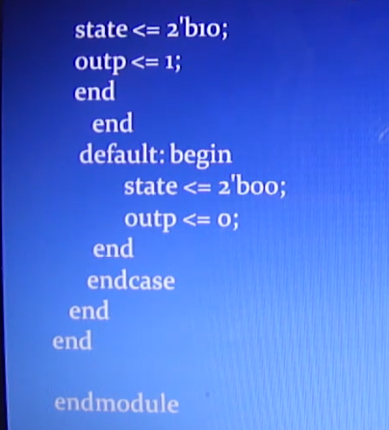

Slide 14
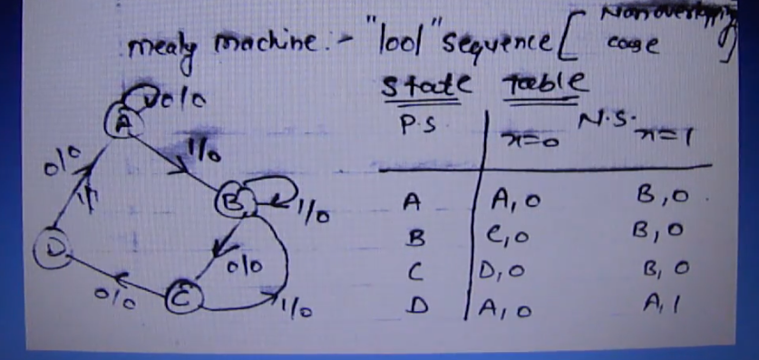
1001 detector , non overlapping

Slide 15
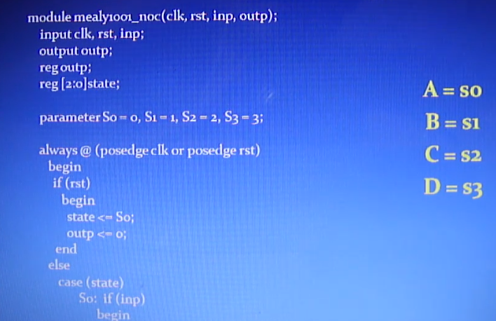

Slide 16
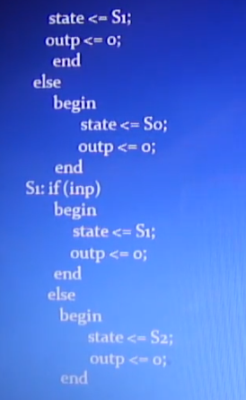
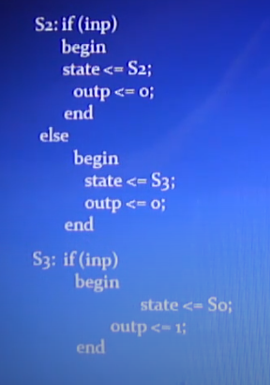
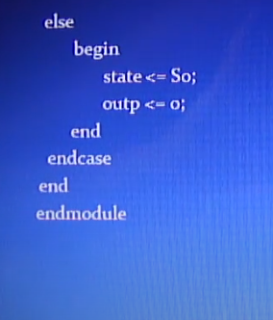

Slide 17
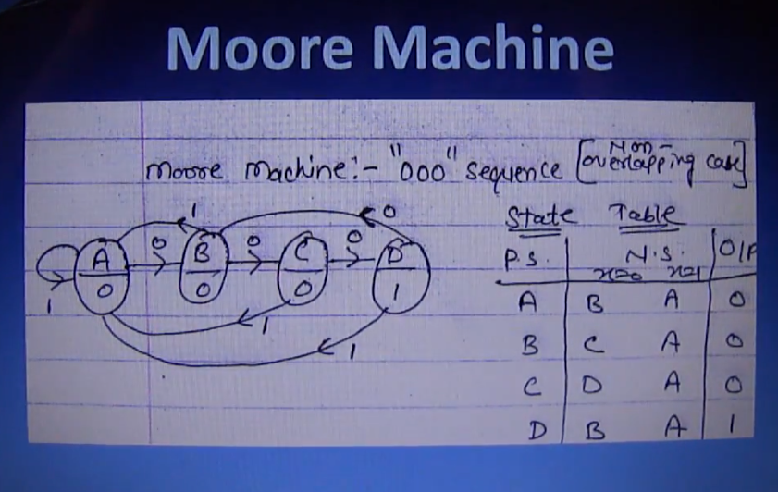
‘000’ DETECTOR –NON OVERLAPPING CASE

Slide 18
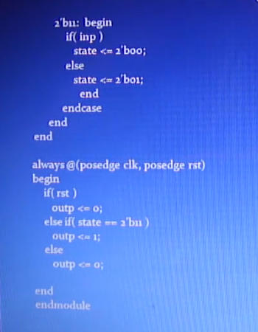
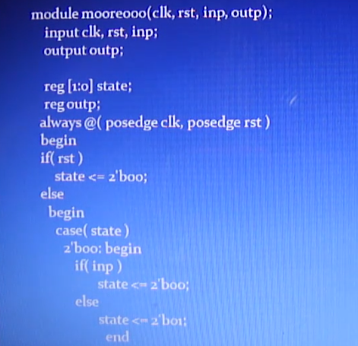
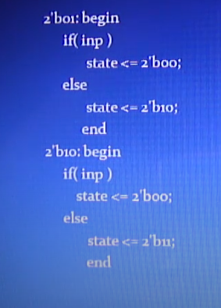

Slide 19
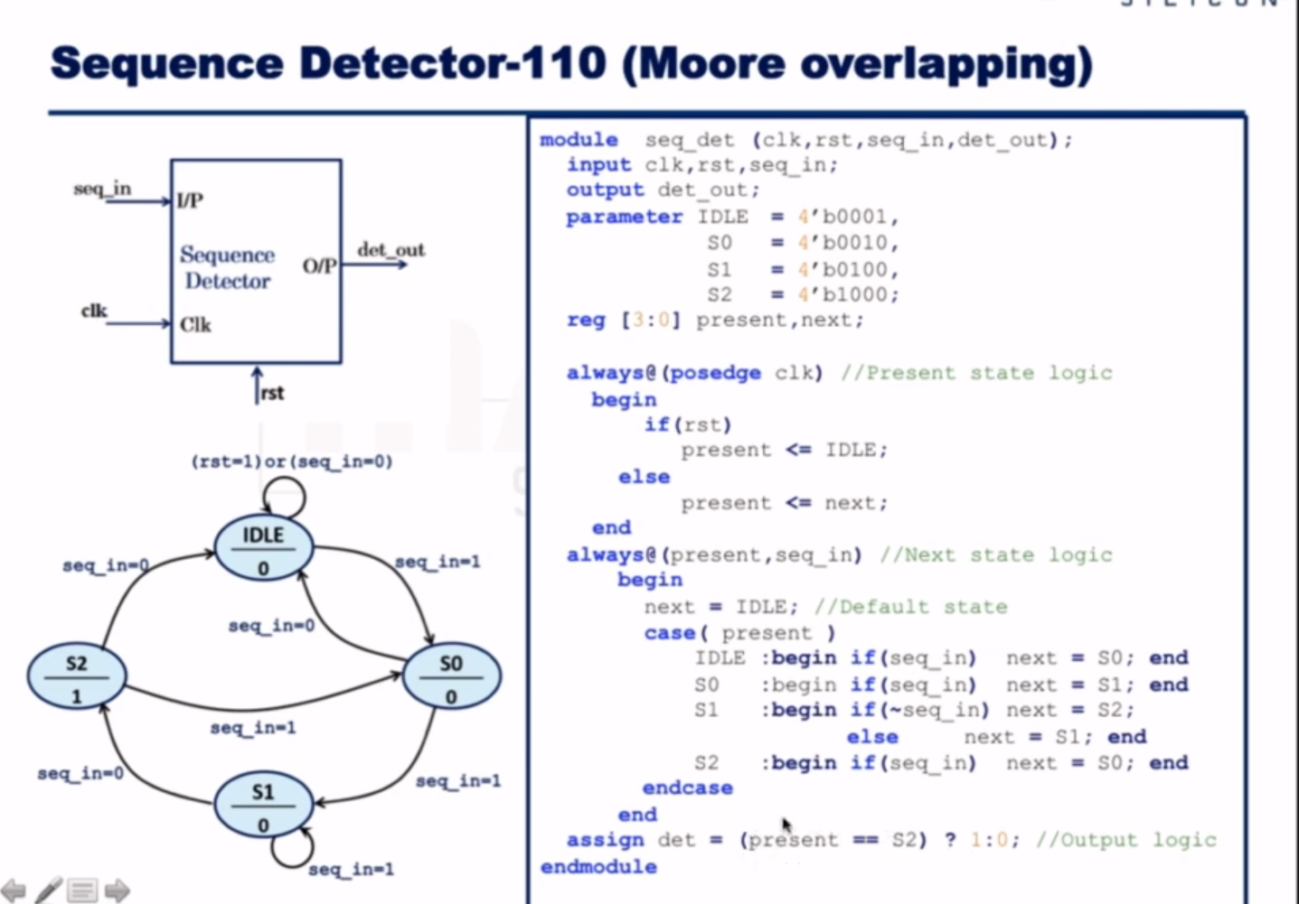

Slide 20
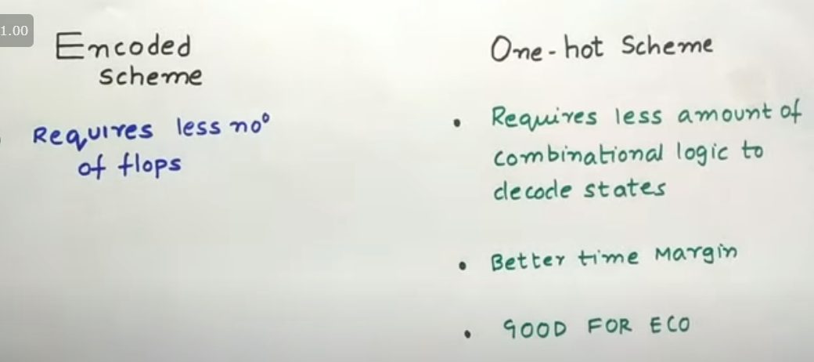
Binary encoding vs one hot encoding
Engineering change order , ECO is the process of inserting a logic change directly into the netlist after it has already been processed by an automatic tool. Before the chip masks are made, ECOs are usually done to save time, by avoiding the need for full ASIC logic synthesis, technology mapping, place ,route, extraction and timing verification. EDA tools are often built with incremental modes of operation to facilitate this type of ECO.

Slide 21
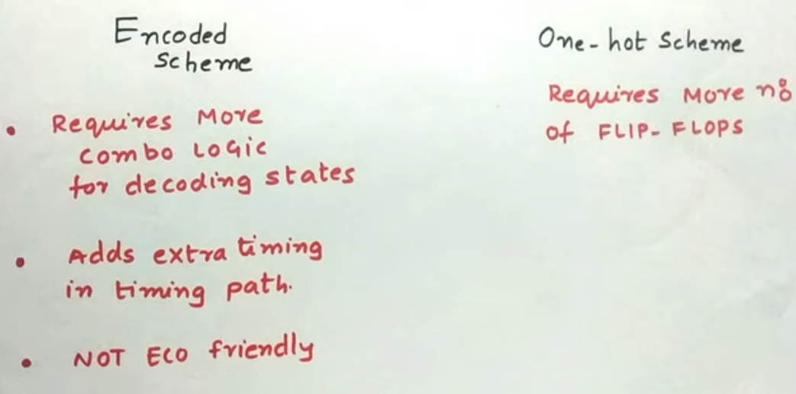
one hot coding also recommend in asic because for debugging it is very easy while when we get timing violation.
But make sure ,there are flipflop available in asic tech incase of resourse constraint , use binary encoding

Slide 22
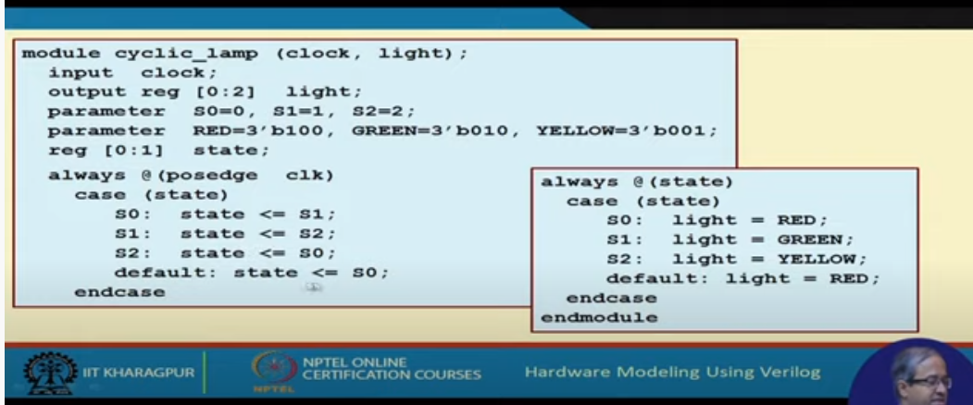

Slide 23
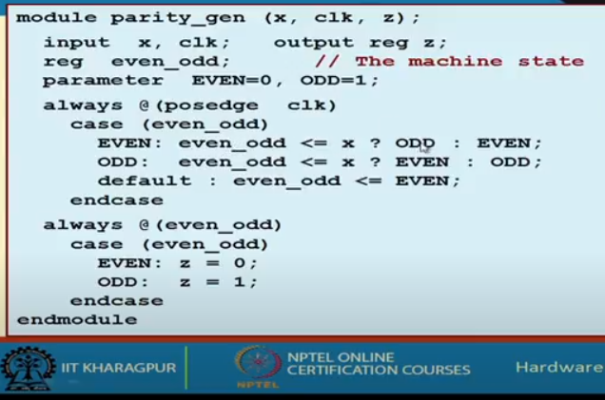

Slide 24
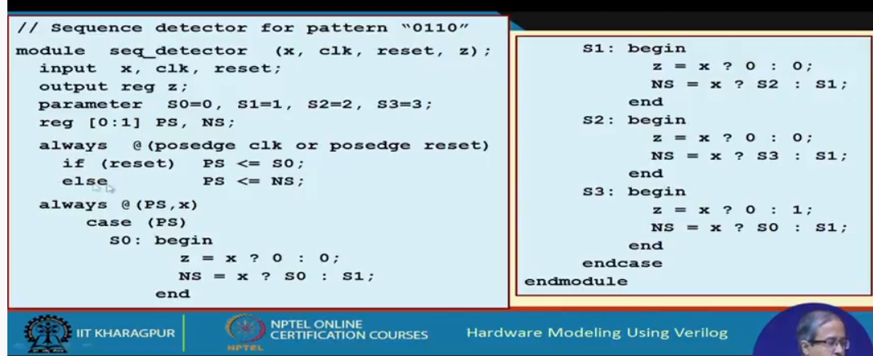

Slide 25
